Slide 1
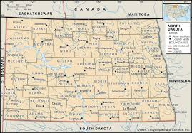
North Dakota SPF-PFS
Strategic Prevention Framework
Partnership for Success
July 11-12, 2017

Slide 2
Training Objectives
Participants will be able to:
Check in with other Grantees on progress related to Strategic Planning, Implementation and Capacity Building
Enhance the implementation of their Strategic Plans
Work on their Evaluation
Hear updates from the State
Network with other North Dakota Coalitions
Obtain additional technical assistance

Slide 3
Training Agenda
Day 1: Tuesday, July 11, 2017
Welcome, Introductions and Objectives
Sharing Activity
Feedback from the State on the Strategic Plans
Implementation
Building Capacity
Day 2: Wednesday, July 12, 2017
Evaluation
Planning
Announcements

Slide 4
Individual Sharing
Meet in Groups of 3 people from different coalitions:
What is your role on the coalition?
What was your role in the Strategic Planning?
What will be your role in Implementation?
What do you look forward to in the next year?

Slide 5
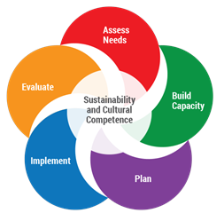
5
Strategic Planning
SAMHSA: Strategic Prevention Framework
Building Safe, Healthy, and Drug Free Communities

Slide 6
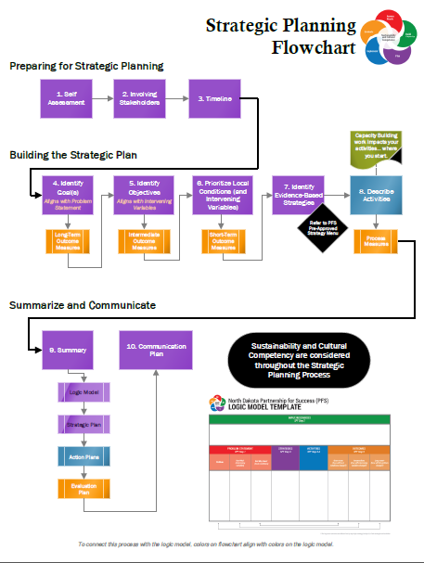
6

Slide 7
Coalition Sharing – Strategic Planning
Community Presentations (5 Minutes):
Who are you? What is your coalition? What is the Community Served?
For your two priority local conditions describe:
- The local condition
- The evidence-based strategies
- Short-term outcomes
Which key community partners will be involved in implementation?
What challenges do you expect?
What are 3 key “next steps” for the coalition

Slide 8
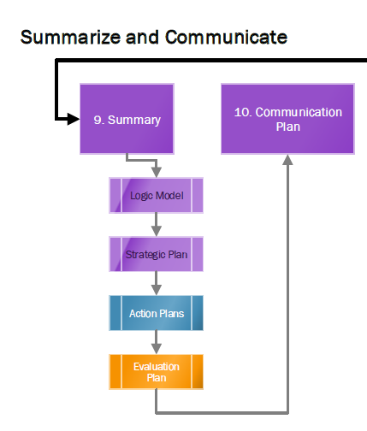
Feedback
The Comprehensive Strategic Plan Includes:
Strategic Plan 9.1 – 9.2
Logic Model 9.3 – 9.11
Action Plans 9.12 Appx. A.
Evaluation Plan 9.12.1
Communication Plan 10.1

Slide 9
9
Implementation & Evaluation
Day 2
Day 1
SAMHSA: Strategic Prevention Framework
Building Safe, Healthy, and Drug Free Communities

Slide 10
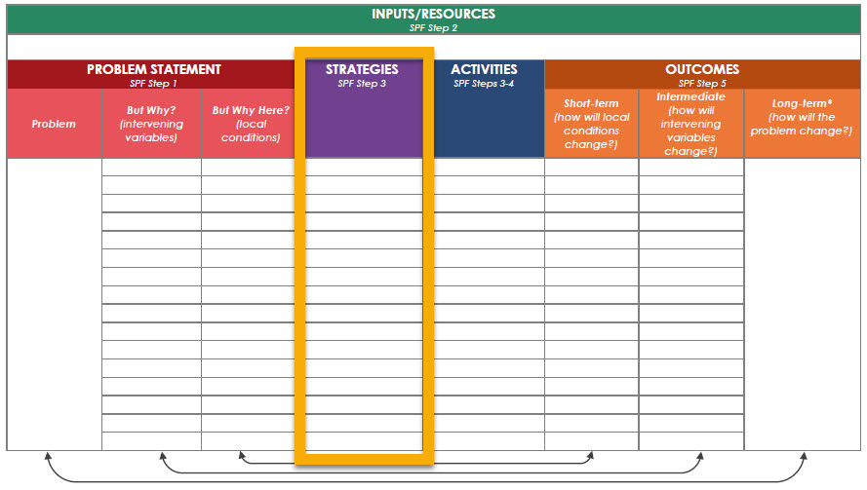
Evidence-Based Strategies

Slide 11
Evidence-Based Strategies
Underage Drinking
Retail Access
Limit, Restrict Location & Density and/or Hours & Days of Sale of Alcohol Outlets
Special Events Permits and Conditions
Checking ID for Alcohol Sales
On-Sale Walk-Throughs
“Cops in Shops” Enforcement Program
Compliance Checks of Alcohol Retailers
Responsible Beverage Service (RBST) Training
Community Norms
School/College/ Worksite Policies
Banning alcohol advertising, restrict sales & consumption to specific area
Local Media Campaign, Media Advocacy, or Positive Community Norm Campaign
Social Access
Limit and Restrict the Location and Social Host Liability Law
Restrict and monitor teen parties at motels/ hotels/ apartments
Alcohol Restrictions at Community Events
Texting Tipline
Restrict age of alcohol servers and sellers
Shoulder Tap Enforcement Programs
Enforcement
Impose appropriate penalties for alcohol law violations, strengthen the prosecution, adjudication, and sanctioning of alcohol laws within the court system
Teen Party Ordinance/Loud Party

Slide 12
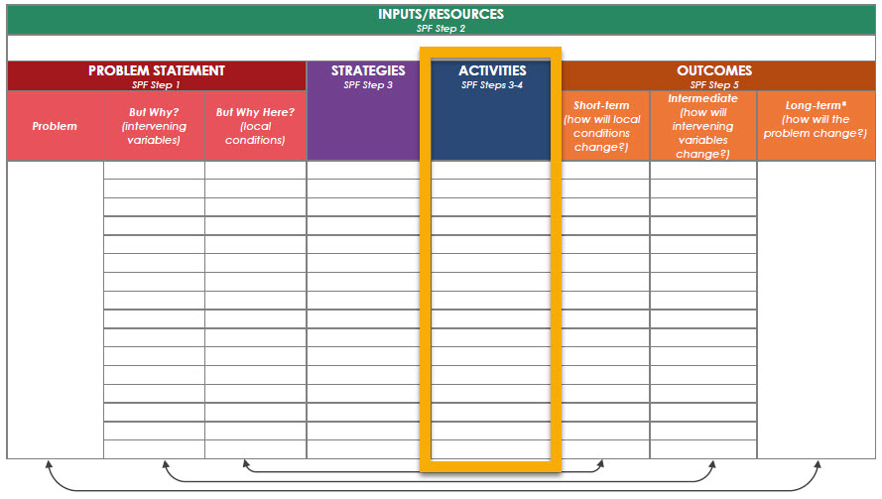
Activities

Slide 13
Activities
Comprehensive Action Planning to Implement your Evidence-based Strategy
1. Provide information
2. Build skills
3. Provide support
4. Change barriers/access
5. Change consequences/incentives
6. Change the physical design
7. Change policies, practices and rules

Slide 14
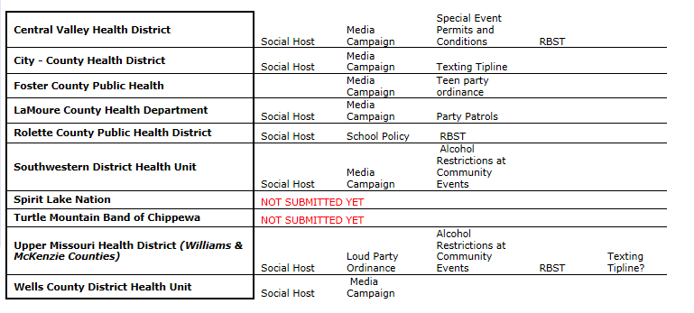
Implementation
Discussion of Common Evidence-Based Strategies

Slide 15
Implementation & Capacity
Part 1: Social Host, Loud Party Ordinance, Teen Party Ordinance, Party Patrol
Part 2: Media Campaign
Part 3: Sequencing Strategies / Engaging the Community
Part 4: Policy Steps
Part 5: Building Capacity Discussion

Slide 16
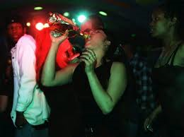
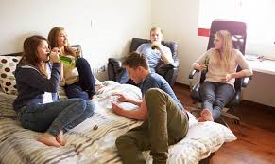
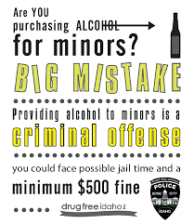
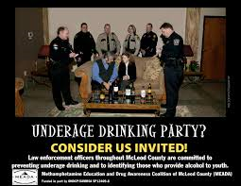
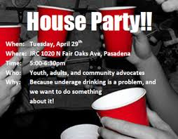
Social Host, Loud Party Ordinance, Teen Party Ordinance, Party Patrol
Local Condition:
Youth Parties with Alcohol in Homes

Slide 17
Social Host, Loud Party Ordinance, Teen Party Ordinance, Party Patrol
Clarify the Local Condition
Review your current assessment:
What data do you that makes the case that “Youth Parties with Alcohol in Homes”?
What additional information do you need?
What community partners need to be involved in the data collection?

Slide 18
Social Host, Loud Party Ordinance, Teen Party Ordinance, Party Patrol
Comprehensive Strategies - Examples
Youth Parties with Alcohol in Homes
1. Provide information
2. Build skills
3. Provide support
4. Change barriers/access
5. Change consequences
6. Change the physical design
7. Change policies
- Media Campaigns Targeting Parents
- Promote Safe Party Practices / Safe Homes Network
- Visible enforcement
- Party Dispersal Training
- Awareness / Social Norm Campaign
- Youth Engagement and Leadership
- Tiplines
- Party Patrols
- Social Host Laws, Teen Party & Noise Ordinances

Slide 19
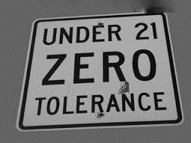
Comprehensive Strategies
Youth Parties with Alcohol in Homes
Laws that can be used to address parties:
Social Host Laws
Teen Party Ordinance
Noise ordinance
Unruly party ordinances
Parking enforcement
Curfew
Providing Alcohol to a Minor
Fire Safety Inspections
Minor in Possession

Slide 20
Comprehensive Strategies
Youth Parties with Alcohol in Homes
Social Host Laws
Social Host Laws Social host address serving alcohol to intoxicated persons and underage consumption
Host must have actual knowledge of the occurrence and apply only to a person who is present and in control of the location at the time underage consumption occurs.

Slide 21
Comprehensive Strategies
Youth Parties with Alcohol in Homes
Teen Party Ordinance
The purpose of a teen party ordinance is to discourage underage drinking parties by creating legal means to sanction the host and party attendees, reducing the incidence and likelihood of underage drinking and off-premise alcohol-sales.

Slide 22
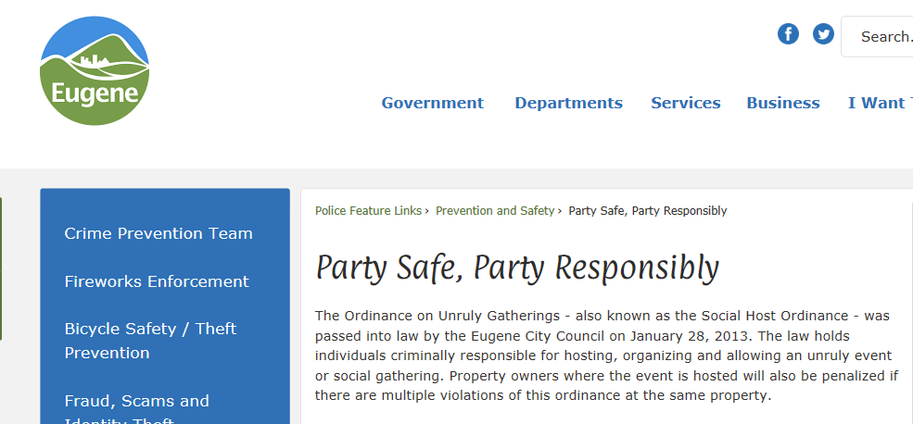
Comprehensive Strategies
Youth Parties with Alcohol in Homes
Unruly Party Ordinance / Noise Ordinance

Slide 23
Which Ordinance is Best for Your Community?
Comprehensive Strategies
Youth Parties with Alcohol in Homes
What existing laws are already in place?
Do we need a new ordinance or better enforcement of an existing ordinance?
What does law enforcement say about their ability enforcement of existing and/or new laws?
What is the political will to address the problem through a new ordinance?

Slide 24
Comprehensive Strategies
Youth Parties with Alcohol in Homes - Examples
1. Provide information
2. Build skills
3. Provide support
4. Change barriers/access
5. Change consequences
6. Change the physical design
7. Change policies
- Media Campaigns Targeting Parents
- Promote Safe Party Practices
- Visible enforcement
- Party Dispersal Training
- Awareness / Social Norm Campaign
- Youth Engagement and Leadership
- Tiplines
- Party Patrols
- Social Host Laws, Teen Party & Noise Ordinances

Slide 25
Media Campaigns Targeting Parents
Comprehensive Strategies
Youth Parties with Alcohol in Homes
Parents Who Host
Grand Forks
Power to the
Parent
SAMHSA – Talk It Up Campaign

Slide 26
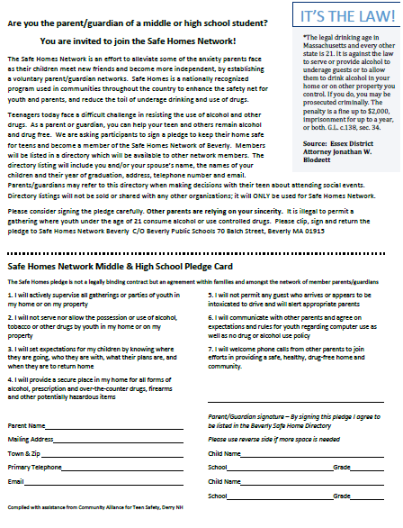
Promote Safe Party Practices
Comprehensive Strategies
Youth Parties with Alcohol in Homes
Provide parents info about the problem of teen parties
Focus on known times: Prom, Graduation
Provide resources to parents
Establish a “Safe Homes Network”
Promote “Parent Pledges”
Encourage parents to be proactive:
- Establish guidelines with their children
- Contact the parents of friends / hosts
- Monitor behaviors (be awake when they get home)

Slide 27
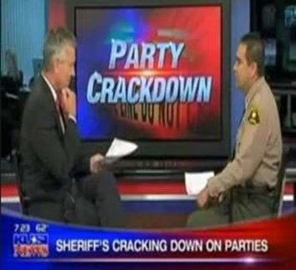
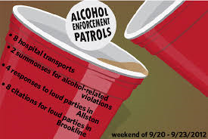
Visible Enforcement
Comprehensive Strategies
Youth Parties with Alcohol in Homes

Slide 28
Party Dispersal Training
Comprehensive Strategies
Youth Parties with Alcohol in Homes
Controlled Party Dispersal – officers are trained to:
Contain the youth involved in the party
Administer Breathalyzer / Photograph
Process citations
Identify adult providers / hosts
Arrange safe transportation

Slide 29
Awareness / Social Norm Campaigns
Comprehensive Strategies
Youth Parties with Alcohol in Homes
The social norms approach finds:
While most youth do not use alcohol or other drugs,
They perceive that the majority of their peers do use alcohol and other drugs
The approach to focuses on:
Gathering real data on norms
Correcting false normative beliefs

Slide 30
Youth Engagement and Leadership
Comprehensive Strategies
Youth Parties with Alcohol in Homes
Promote youth engagement & leadership by:
Work with existing youth councils, groups, organizations
Empower youth who care about this issue – provide opportunities for them to get involved
Promote alcohol-free opportunities and activities in the community

Slide 31
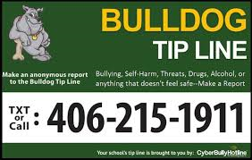
Tiplines
Comprehensive Strategies
Youth Parties with Alcohol in Homes
Determine who will monitor the tipline
Determine coverage of a Tipline (multi-county, county, city)
Gain support from law enforcement and community
Promote the tip line and provide information to the public on how to use it

Slide 32
Party Patrols
Comprehensive Strategies
Youth Parties with Alcohol in Homes
Party Patrols:
Training provided to law enforcement
Patrol selected neighborhoods on selected nights
Respond to complaints about parties / noise
Party hosts may also call to request assistance with shutting down an out of control party

Slide 33
Comprehensive Strategies
Youth Parties with Alcohol in Homes - Examples
1. Provide information
2. Build skills
3. Provide support
4. Change barriers/access
5. Change consequences
6. Change the physical design
7. Change policies
- Media Campaigns Targeting Parents
- Promote Safe Party Practices
- Visible enforcement
- Party Dispersal Training
- Awareness / Social Norm Campaign
- Youth Engagement and Leadership
- Tiplines
- Party Patrols
- Social Host Laws, Teen Party & Noise Ordinances

Slide 34
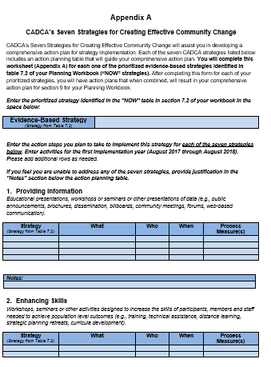
Social Host, Loud Party Ordinance, Teen Party Ordinance, Party Patrol
ACTIVITY
Review your Strategies & Action Plans for one Priority Local Condition:
What specific policy is to be changed? Have you confirmed with law enforcement?
How do your other strategies “complement” the policy change?
Are there other strategies to include?

Slide 35
Implementation
Part 1: Social Host, Loud Party Ordinance, Teen Party Ordinance, Party Patrol
Part 2: Media Campaign
Part 3: Sequencing Strategies / Engaging the Community
Part 4: Policy Steps
Part 5: Building Capacity Discussion

Slide 36
Local Media Campaign, Media Advocacy, or Positive Community Norm Campaign
Description:
This strategy uses multifaceted, targeted media efforts to dispel misperceptions, gain community support, and enhance prevention efforts.
Media Campaigns directly relate to a priority local condition – this provides the “content” for the campaign.

Slide 37
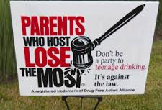
Local Media Campaign, Media Advocacy, or Positive Community Norm Campaign
What local conditions are addressed by these campaigns?
Notes:
NOTE: For the training you can create individual slides for each picture.

Slide 38
Local Media Campaign, Media Advocacy, or Positive Community Norm Campaign
Goal is to establish a compelling message and marketing campaign that resonates with ALL target audiences in order to address a local condition
This will be achieved by creating a powerful campaign using a wide range of media that:
Informs and educates about the dangers of underage drinking
Informs each audience as to the role they play in the effort
Encourages positive action

Slide 39
Creating a Social Marketing Campaign
Social marketing is the use of commercial marketing principles and techniques to promote the adoption of a behavior that will improve the health or well-being of the target audience or of a society as a whole.
Notes:
So we are going to walk through creating a social marketing campaign for your community. The best part is the messages and many of the materials are created for you and today we will walk through the steps for you to determine your implementation plan.

Slide 40
Target Audience
One size does not fit all – considerations include:
Geography
Demographics
Attitudes
Behaviors
Culture and diversity
Each audience is unique which requires different types of communication and strategies.

Slide 41
Know your audience
How do they get messages?
What programs/services do they need to act on behavior change?
What would have the greatest effect on changing the behavior?

Slide 42
Example: Truth Campaign
Research showed youth started smoking because
Desire to rebel against authority
Drive toward independence and self-expression
Wanting to be part of a group
Truth Campaign…Redirected aim.

Slide 43
Example: Parents Who Host

Slide 44
Comprehensive Strategies
Media Campaign - Examples
1. Provide information
2. Build skills
3. Provide support
4. Change barriers/access
5. Change consequences
6. Change the physical design
7. Change policies
- Op Ed; Town Hall Meeting; Yard Signs
Promote Safe Party Practices; Educate – Homeowners Insurance Risk; Safe Homes Network
Provide Yard Signs – “Parents Who Host”
Pledge To Lock Up Alcohol – Fridge Locks
Recognize Parents That Sign Pledge – School News Letters;
Advertise – Best Place To Get Alcohol Next To The Fridge
POLICY CHANGE = Social Host Law

Slide 45
Local Media Campaign, Media Advocacy, or Positive Community Norm Campaign
ACTIVITY
Review your Strategies & Action Plans for one Priority Local Condition:
Who are the specific targeted audiences?
What is the message for each audience?
How will you communicate the message.

Slide 46
Implementation
Part 1: Social Host, Loud Party Ordinance, Teen Party Ordinance, Party Patrol
Part 2: Media Campaign
Part 3: Sequencing Strategies / Engaging the Community
Part 4: Policy Steps
Part 5: Building Capacity Discussion

Slide 47
Sequencing Strategies
Which strategies / activities should be implemented first?
Considerations include:
Start with providing information to raise awareness of the issue and proposed strategies
Identify specific target audiences to receive the info
Engage the enforcement agency early in the process
Include on-going data collection in your effort
Determine when the timing will be best for a vote

Slide 48
Engaging Coalition Members & Partners
Who should be involved?
Considerations include:
Form an Action Team
Ensure that enforcement and media is represented
Use the Sector List to identify the specific sectors to engage – ask Sector Rep for recommendations
Engage representatives from each of the Jurisdictions that will be implementing the policy / ordinance
Reach out to diverse cultures

Slide 49
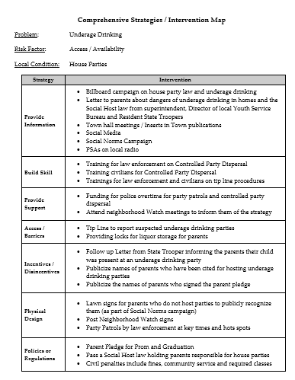
Practice
Sequencing Strategies & Engaging Partners
Review the Comprehensive Strategies / Intervention Map
Determine which strategies will be implemented in the next 6 months.
3. Identify 6 - 8 organizations or groups to join the Action Team.

Slide 50
ACTIVITY
Sequencing Strategies & Engaging Partners
Review your Strategies & Action Plans for 1 Priority Local Condition
Determine which strategies will be implemented in 4 – 6 months.
3. Identify for 6 - 8 organizations or groups to join the Action Team.

Slide 51
Implementation
Part 1: Social Host, Loud Party Ordinance, Teen Party Ordinance, Party Patrol
Part 2: Media Campaign
Part 3: Sequencing Strategies / Engaging the Community
Part 4: Policy Steps
Part 5: Building Capacity Discussion

Slide 52
Policy Development Steps
Clearly state the problem
Engage enforcement
Gather and analyze data to make your case
Research model legislation/policies
Draft policy language
Use media to educate
Mobilize support and provide community education
Get the policy adopted
Ensure enforcement of the policy
Evaluate effects of policy change
The Line
Internal
External
Internal

Slide 53
Policy Development Steps
Clearly state the problem
Engage enforcement
Gather and analyze data to make your case
Research model legislation/policies
Internal
Steps 1 – 4 allows the coalition to:
Clarify the local condition
Fully research the proposed policy solution
Ensure consensus among coalition members and key community partners

Slide 54
Policy Development Steps
Step 1: Clearly State the Problem to be Addressed
Write a Policy/Action statement (25 words or less):
State the problem (local condition)
State a policy solution
What will the policy do?
Who will benefit from the policy?
Who are the decision makers (who can make it happen)?

Slide 55
Step 1: Clearly state the problem (local condition) to be addressed
Policy Development Steps
Policy Action Statement—example
City Council passes a social host ordinance holding parents / hosts responsible for underage drinking that occurs in their homes – with or without their knowledge - resulting in fewer teen parties in homes with alcohol and resulting consequences.

Slide 56
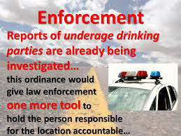
Policy Development Steps
Step 2: Engage enforcement agencies in the policy development process
Include representatives from agencies who will enforce the policy in all steps:
Collection of local data
Identification of local conditions
Selection of policy responses
Crafting policy language

Slide 57
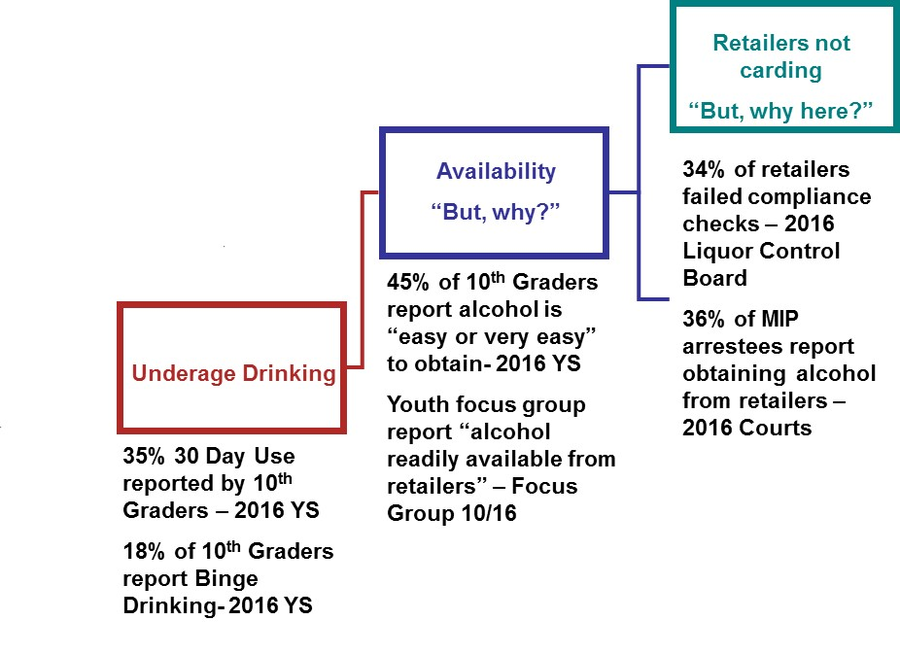
Policy Development Steps
Step 3: Gather & analyze data to make your case
Use the quantitative and qualitative data from your community assessment and logic model to answer the question:
“How do we know it’s a problem?”

Slide 58
Policy Development Steps
Step 3: Gather & analyze data to make your case
Describe the Evidence Base
for the proposed policy and cite relevant community successes to answer the question:
“How do we know this proposed policy solution will work”?

Slide 59
Policy Development Steps
Step 4: Research model legislation/policies
Research model legislation / policies
Create an Issue brief to increase awareness
Describe the problem and its impact on the community
Identify costs to community if problem is not resolved
Explain how the proposed policy addresses community concerns

Slide 60
Policy Development Steps
Step 4: Research model legislation/policies

Slide 61
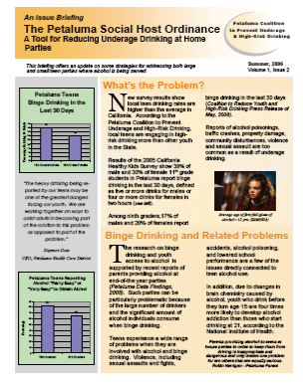
Policy Development Steps
Step 4: Create an Issue Brief

Slide 62
Policy Development Steps
Clearly state the problem
Engage enforcement
Gather and analyze data to make your case
Research model legislation/policies
Draft policy language
Use media to educate
Mobilize support and provide community education
Get the policy adopted
Ensure enforcement of the policy
Evaluate effects of policy change
The Line
Internal
External
Internal

Slide 63
Educating vs. Lobbying What Organizations Need to Know

Slide 64
Q: What is education in a policy context? A: Education is sharing data and information

Slide 65
Q: What Is Lobbying?
A: Lobbying refers to communications intended to influence specific legislation.
20
Notes:
DIRECT
Communications with a legislative member/ staff that express a view on specific legislation.
GRASS ROOTS
Call to action that encourages the public to contact legislators about specific legislation.

Slide 66
Implementation
Part 1: Social Host, Loud Party Ordinance, Teen Party Ordinance, Party Patrol
Part 2: Media Campaign
Part 3: Sequencing Strategies / Engaging the Community
Part 4: Policy Steps
Part 5: Building Capacity Discussion

Slide 67
Building Capacity

Slide 68
Building Coalition & Community Capacity
Cultural Competence

Slide 69
Readiness
Readiness is “the degree to which an organization or community is ready to take action on underage drinking.”
Understanding readiness allows you to tailor strategies to what the coalition and/or community is willing to accept and get involved in.
Just because a community is at a lower level of readiness to address the problem, doesn’t mean the problem can’t still be addressed.
Notes:
With the group – brainstorm a list of health-related coalitions / initiatives in Wyoming.
Present the Community Initiatives Worksheet
Let’s talk about who would oppose the effort? Brainstorm???
Community Inititatives Worksheet HANDOUT page 1
Columns:
Initiative
Lead partners
Projects/Activities
Contact person
Funding source
Currently a member of the coalition

Slide 70
Resources
A community needs resources to establish and maintain a prevention system that includes:
Building human resources involves identifying, engaging and recruiting individuals and organizations to participate in the coalition and prevention related efforts.
Structural resources are the programs, facilities, supplies, systems, laws, policies, relationships, etc. that support and promote healthy behaviors.
Notes:
With the group – brainstorm a list of health-related coalitions / initiatives in Wyoming.
Present the Community Initiatives Worksheet
Let’s talk about who would oppose the effort? Brainstorm???
Community Inititatives Worksheet HANDOUT page 1
Columns:
Initiative
Lead partners
Projects/Activities
Contact person
Funding source
Currently a member of the coalition

Slide 71
Cultural Competence
Cultural Competence is…
“ A set of behaviors, attitudes and policies that come together in a system, agency or program or among individuals, enabling them to function effectively in diverse cultural interactions and similarities within, among and between groups.”
U.S. Dept. of Health and Human Services
Notes:
With the group – brainstorm a list of health-related coalitions / initiatives in Wyoming.
Present the Community Initiatives Worksheet
Let’s talk about who would oppose the effort? Brainstorm???
Community Inititatives Worksheet HANDOUT page 1
Columns:
Initiative
Lead partners
Projects/Activities
Contact person
Funding source
Currently a member of the coalition

Slide 72
Building Coalition and Community Capacity
Discussion
What are your current plans to address build coalition and community capacity?
How are you being culturally competent in your capacity building? Please provide and example?
What issues and challenges do you currently face or anticipate?
What additional support and/or information do you need to address these issues?

Slide 73
Day 2: Evaluation

Slide 74
74
Planning Time
Engage your Core Team
Action Plan – what you will do next week when you return to your community?
Long-term Timeline – create a timeline for how you will complete the work in the next 4 months.
Building Safe, Healthy, and Drug Free Communities

Slide 75
75
Report Out
Describe 3 key steps you will take to:
Create / build your core team
Plan for the Capacity Building and Strategic Plans
Building Safe, Healthy, and Drug Free Communities

Slide 76
76
Webinar #4
Date:
Time: 10:00 AM – 11:30 AM CT
Topics:
Check-in with Grantees
Update from the State
Discuss Implemetation
Evaluation Discussion
Building Safe, Healthy, and Drug Free Communities

Slide 77
77
CADCA Resources
CADCA – Community Anti-Drug Coalitions of America
www.cadca.org
Help & Technical Assistance – Contact:
1-800-54CADCA x240
training@cadca.org
Building Safe, Healthy, and Drug Free Communities

Slide 78
78
Celebration
Thank You!
Building Safe, Healthy, and Drug Free Communities

